Slide 1
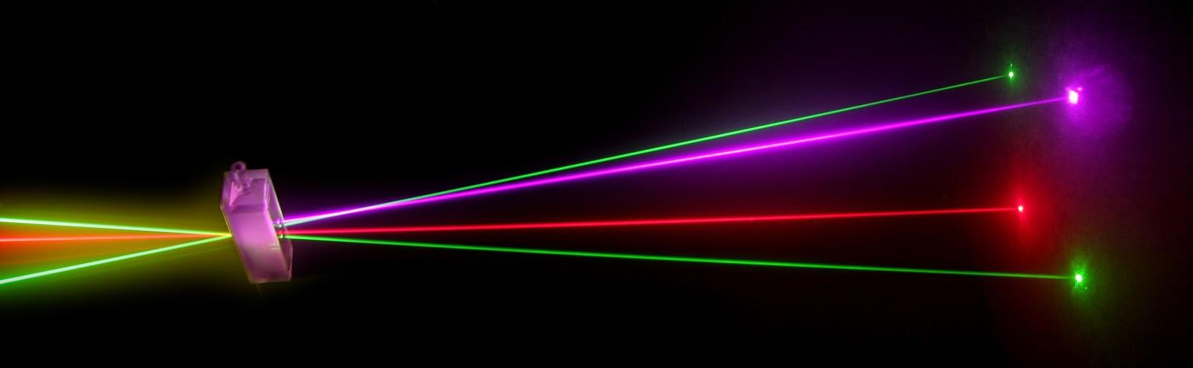
“Laser Technology and Applications” 16B1NPH533 Lecture 18
Notes:
1

Slide 2
Lecture 18 Content Outlines
Modes of a Rectangular Cavity and the Open Planar Resonator

Slide 3

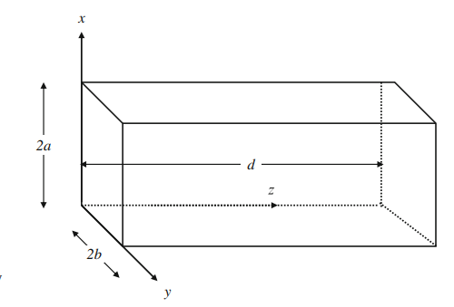

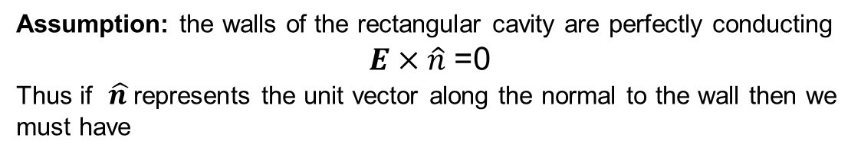
Modes of a Rectangular Cavity and the Open Planar Resonator
Assumption: the walls of the rectangular cavity are perfectly conducting
$E×\hat{n}$ =0
Thus if $\hat{n }$represents the unit vector along the normal to the wall then we must have
We use the method of separation of variables and write
E_{x} = X(x)Y(y)Z(z)T(t)
Time dependence is of the form T(t) = Ae^{−iωt}

Slide 4
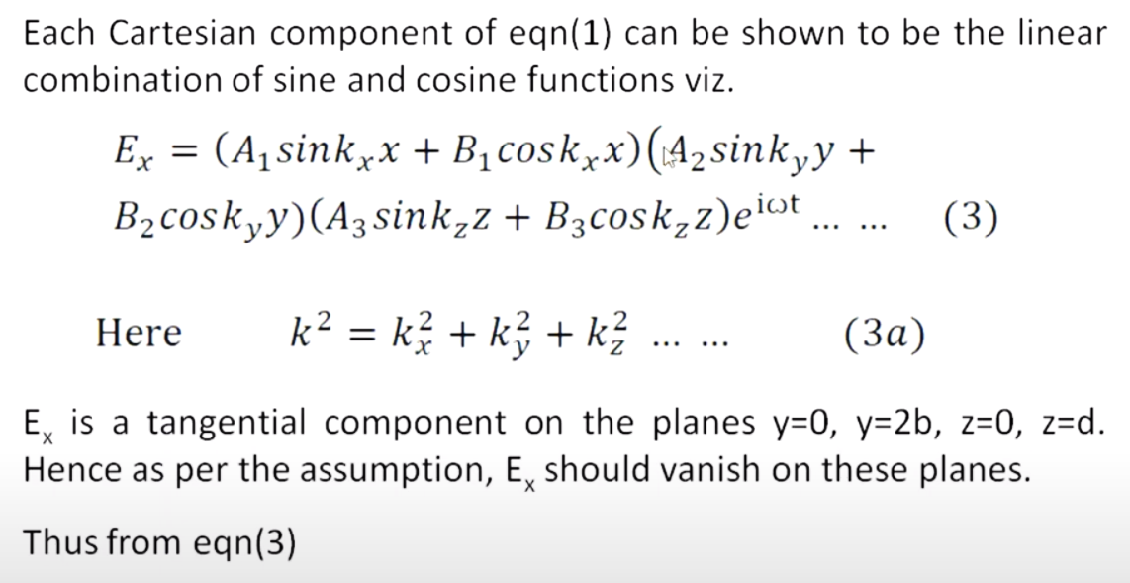
B₂ = B₃ = 0 Sink_{y}y = 0 at y = 2b

Slide 5
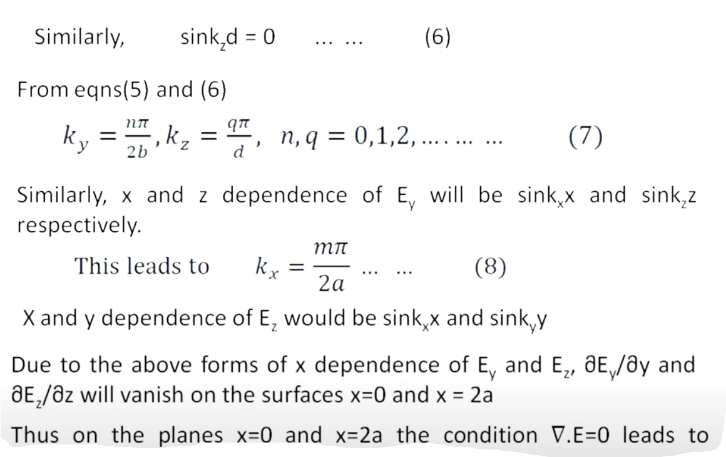

$${∂Ex}/{∂y}=0$$

Slide 6
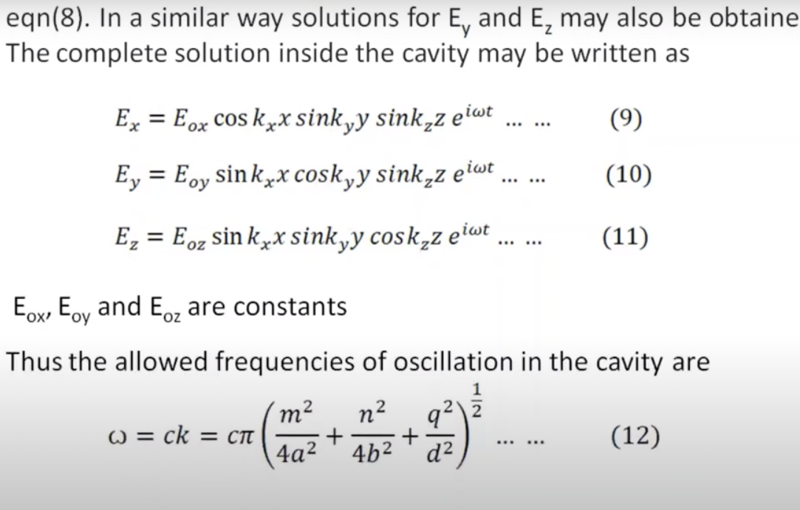
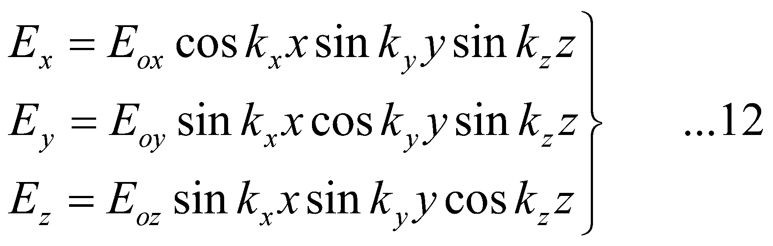
E_{x} must have cos k_{x}x dependence
Field configurations given by Eq. 9,10,11 represent standing wave patterns in the cavity and are called modes of oscillation of the cavity.

Slide 7
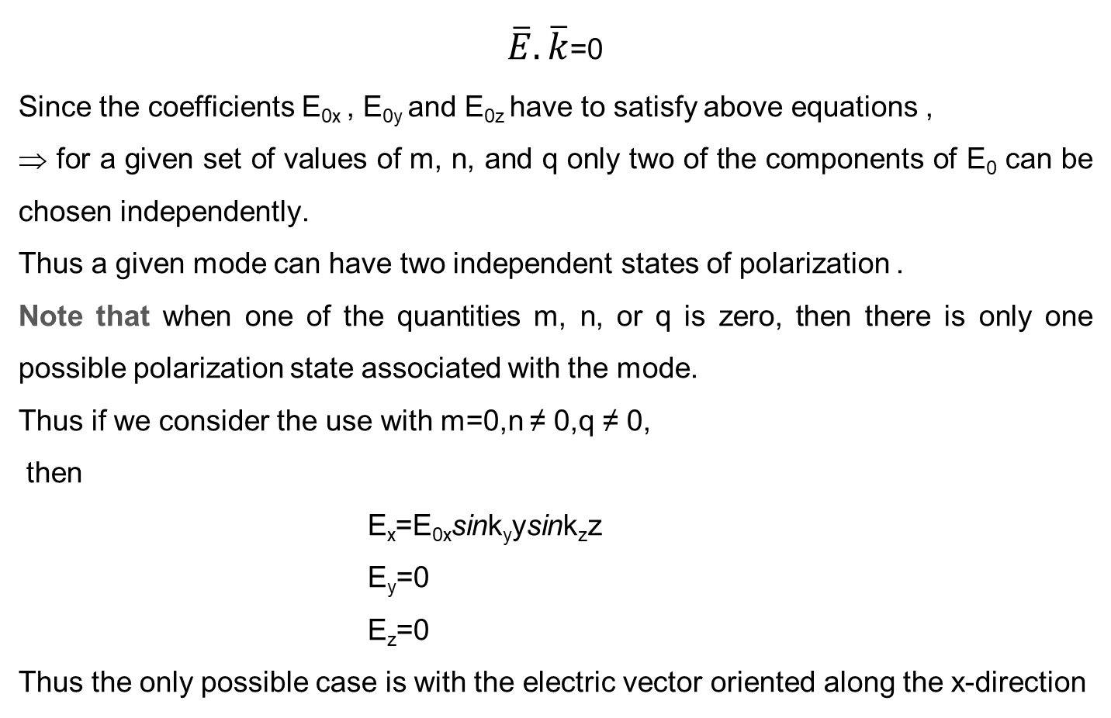
$\overline{E}.\overline{k}$=0
Since the coefficients E_{0x} , E_{0y} and E_{0z} have to satisfy above equations ,
⇒ for a given set of values of m, n, and q only two of the components of E₀ can be chosen independently.
Thus a given mode can have two independent states of polarization .
Note that when one of the quantities m, n, or q is zero, then there is only one possible polarization state associated with the mode.
Thus if we consider the use with m=0,n ≠ 0,q ≠ 0,
then
E_{x}=E_{0x}sink_{y}ysink_{z}z
E_{y}=0
E_{z}=0
Thus the only possible case is with the electric vector oriented along the x-direction

Slide 8
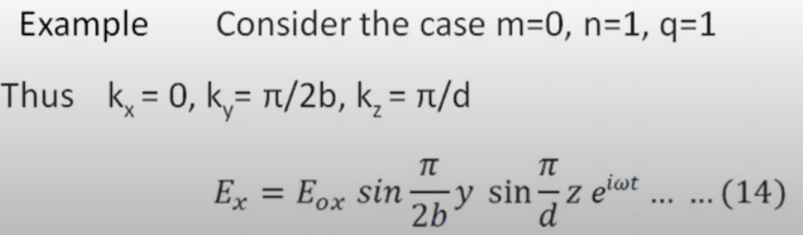
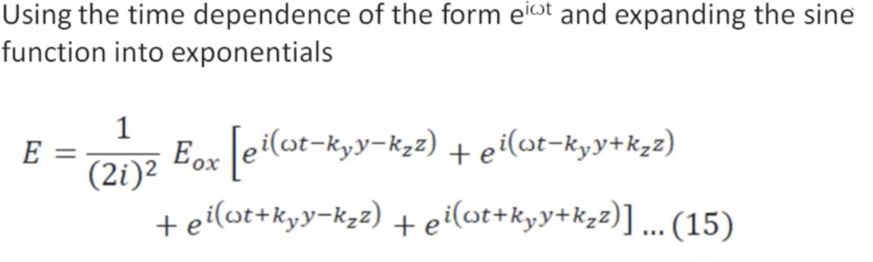
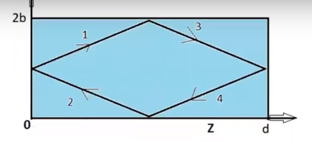
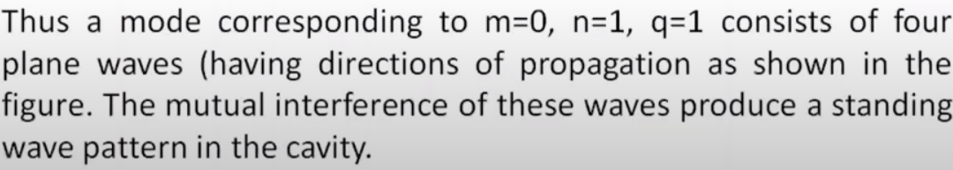

Slide 9
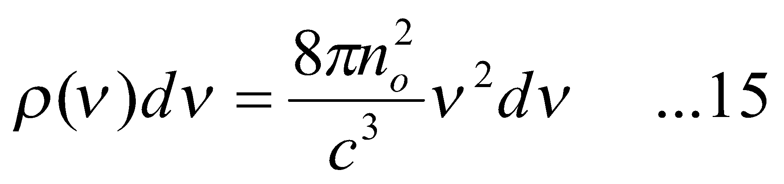
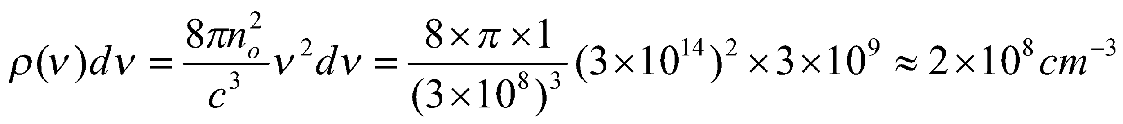
The number of modes per unit volume in a frequency interval from ν to ν+dν will be given by
Where n₀ represents the refractive index of the medium filling the cavity. For a typical atomic system
dν∼3×10⁹Hz at ν=3×10¹⁴Hz
and the number of modes per unit volume would be (assuming n₀=1)
Thus the emission would be far from monochromatic.

Slide 10
Remedy:
To achieve a very small number of possible oscillating modes within the linewidth of the atomic transition, the volume of the cavity has to be made very small.
In the case of conventional lasers the volume of the cavity is large and thus the number of oscillating modes within the linewidth of the atomic transition is very large.
If the dimensions of the cavity are chosen to be of the order of the wavelength, then the volume of the atomic system available for lasing becomes quite small and the power would be quite small.
The problem of the extremely large number of oscillating modes can be over-come by using open cavities(as against closed cavities) .

Slide 11
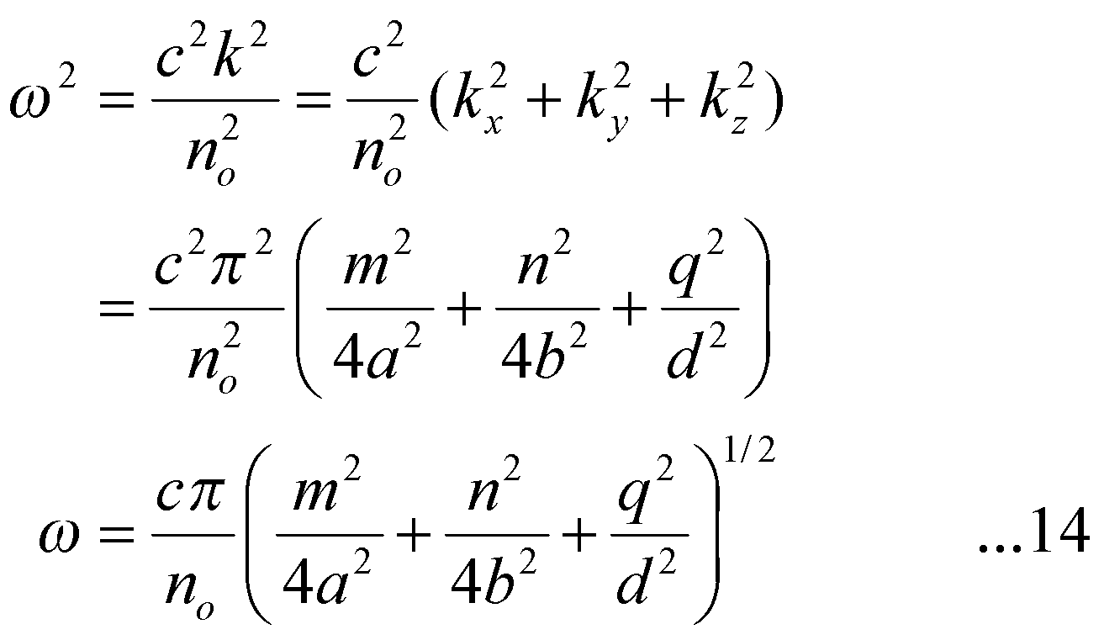
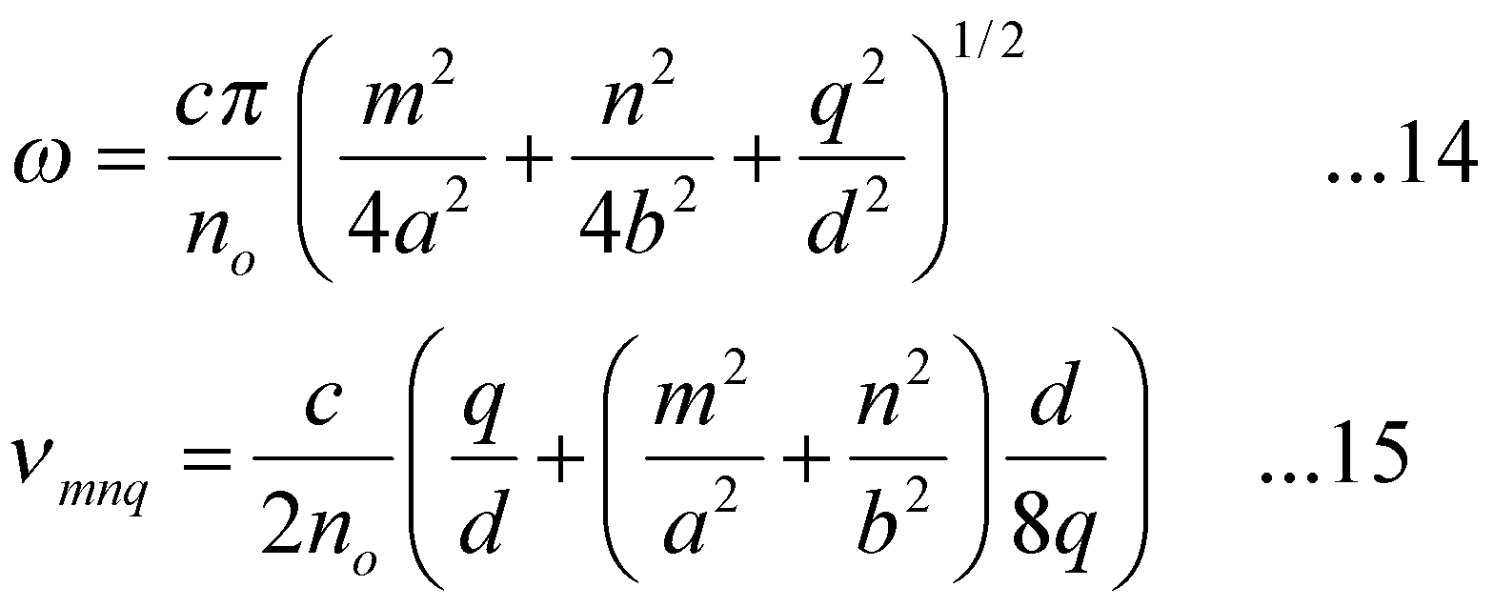
In order to obtain an approximate value for the oscillation frequencies of the modes of an open cavity, we may again use Eq. (14) with the condition m,n<<q. Thus making a binomial expansion in Eq. (14) we obtain

Slide 12
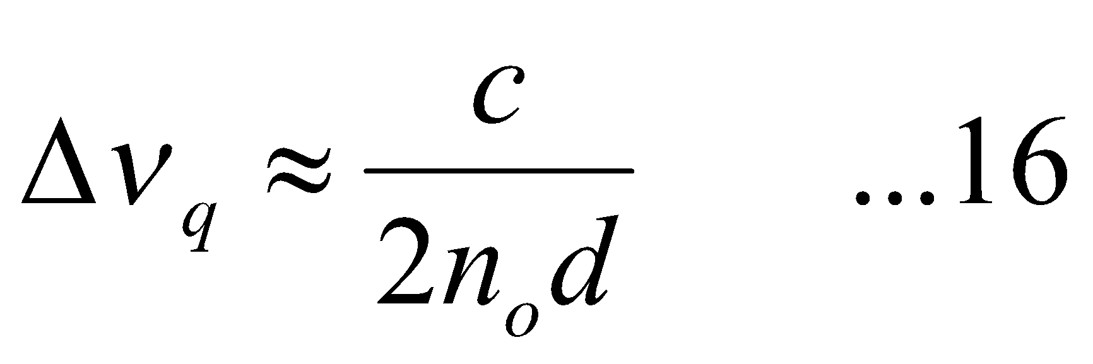
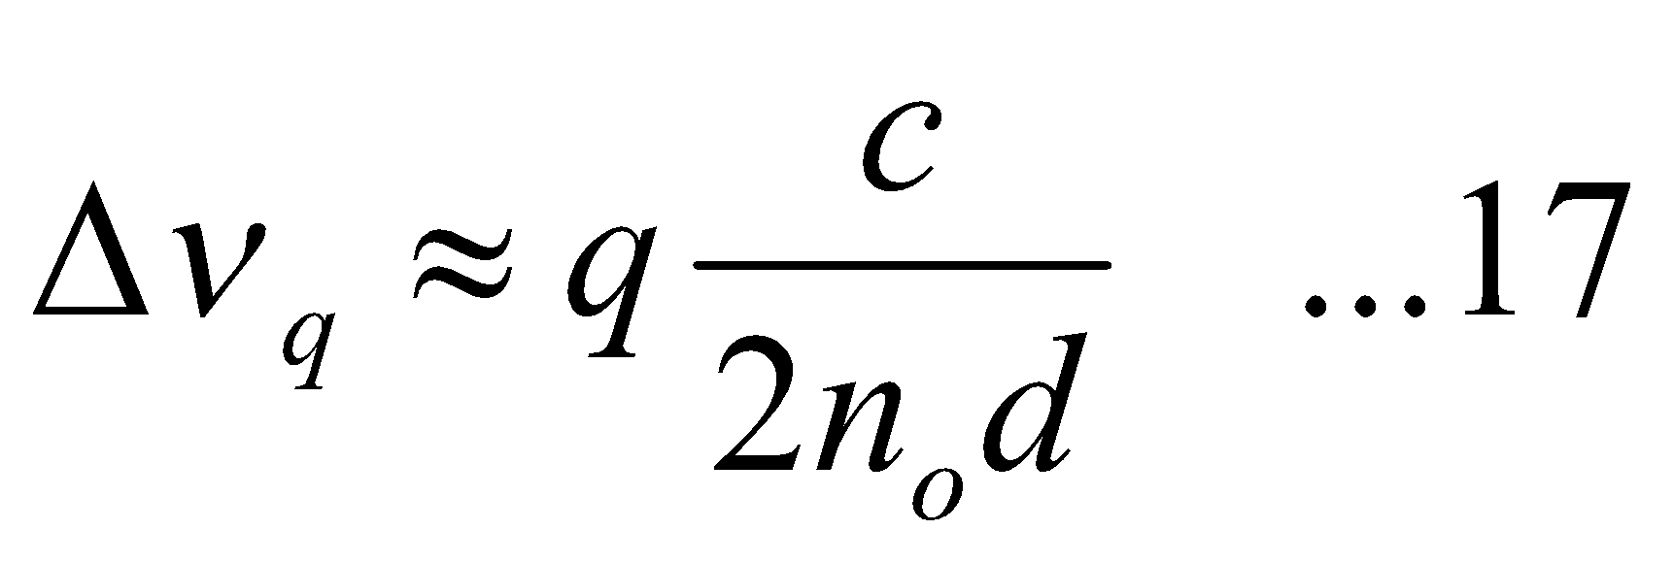
The difference in frequency between two adjacent modes having same values of m and n and differing in q value by unity would be very nearly given by
which corresponds to the longitudinal mode spacing. In addition if we completely neglect the terms containing m and n in Eq. (15) we will obtain
The above equation is similar to the frequencies of oscillation of a stretched string of length d.

Slide 13
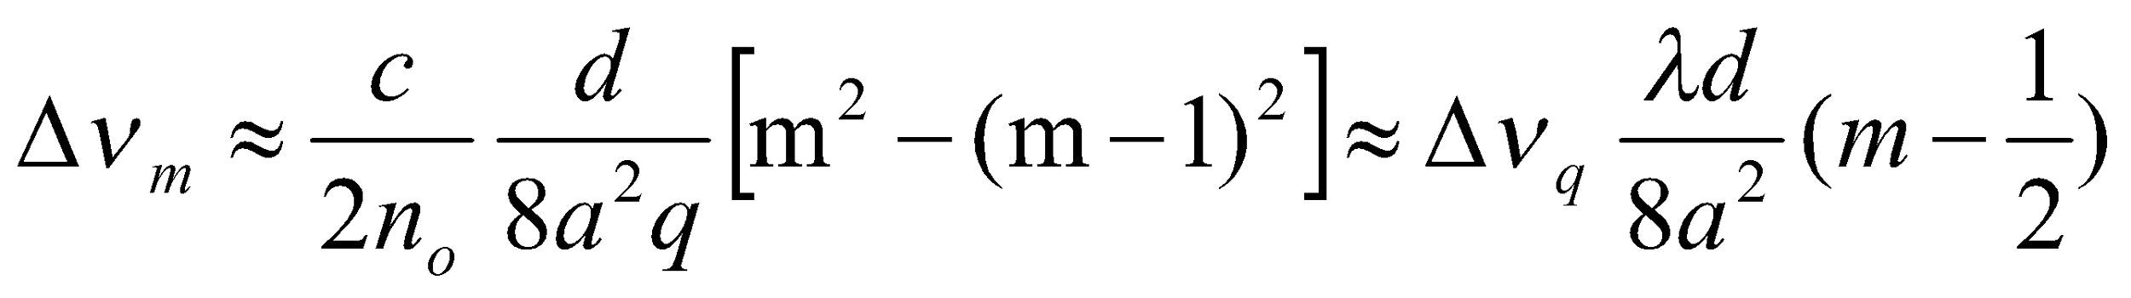
🕮 For a typical laser resonatord∼100 cm and assuming free space filling the cavity, the longitudinal mode spacing comes out to be∼150 MHz which corresponds to a wavelength spacing of approximately 0.18 pm (=0.18×10^{–12} m) at a wavelength of 600 nm.
🕮 Show that the separation between two adjacent transverse modes is much smaller than Δν_{q}.
Solution The frequency separation between two modes differing in m values by unity would be
Where we have used q ≈ 2d/λ . For typical values of λ=600 nm, d=100 cm, a=1cm, λ/d8a²=7.5×10⁻⁴. Thus for m∼1,, Δν_{m} << Δν_{q}.

